Slide 1
Panel Block Shop
2019-28979 공민철
PBS

Slide 2
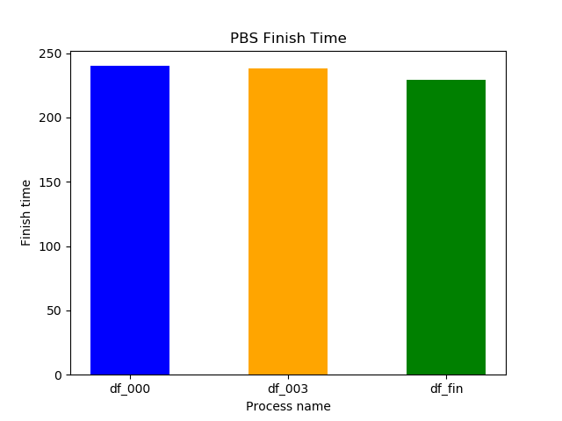
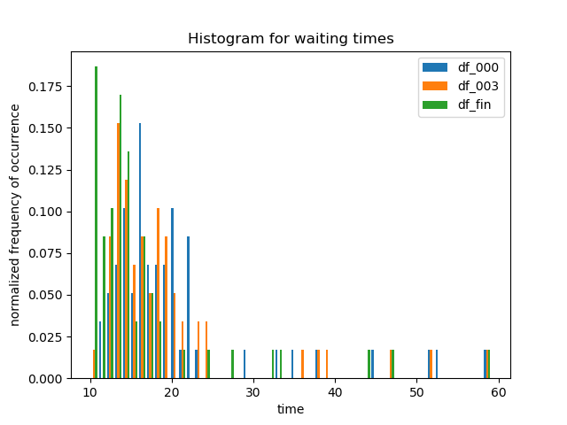
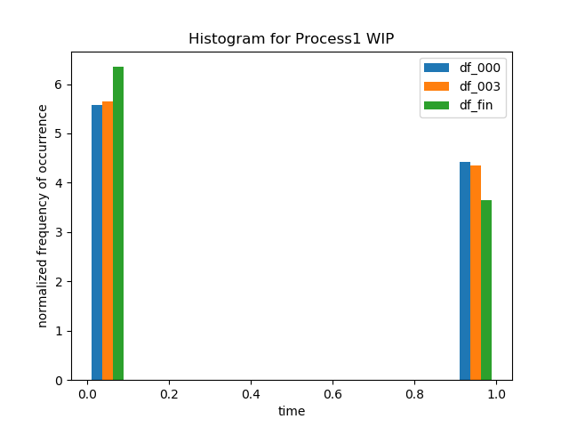
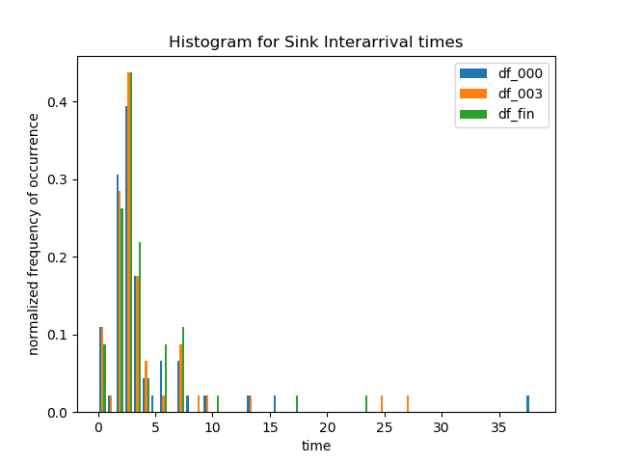
Charts Result
Process 1
Process 2
Process 3
Process 4
Process 5
Process 6
Process 7
240.0
238.0
228.9
PBS

Slide 3
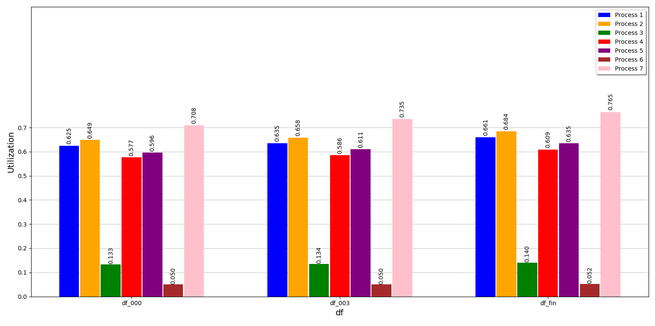
Process.working_time/PBS_Sink.last_arrival

